Slide 1
Example of plots
Data source is from a subset of an unpublished test dataset.
Please do not use these demonstrated plots without asking for permission.

Slide 2
Pipeline and Steps
Input with
Raw Data
Data Trimming
(Trim-Galore 0.6.5)
Map to Genome
(STAR 2.7.3a)
Count Reads
(HTseq Count 0.6.1)
Extract gene counts (Avg counts>10)
Plots for DEGs
(Vennerable, ggplot2, ComplexHeatmap)
Call DEGs
(Deseq2)
GO Analysis
(David 6.8)

Slide 3
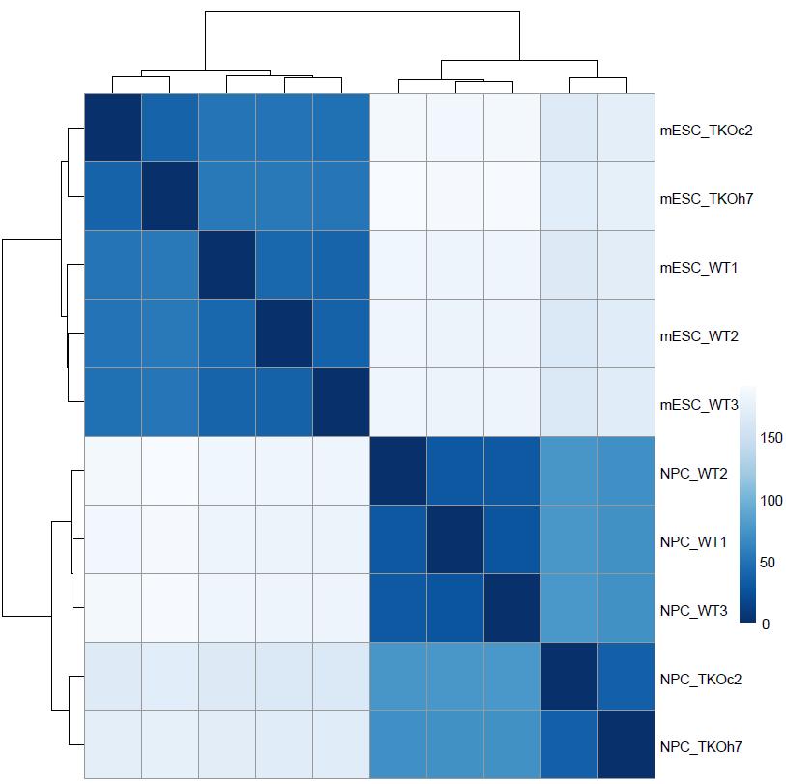
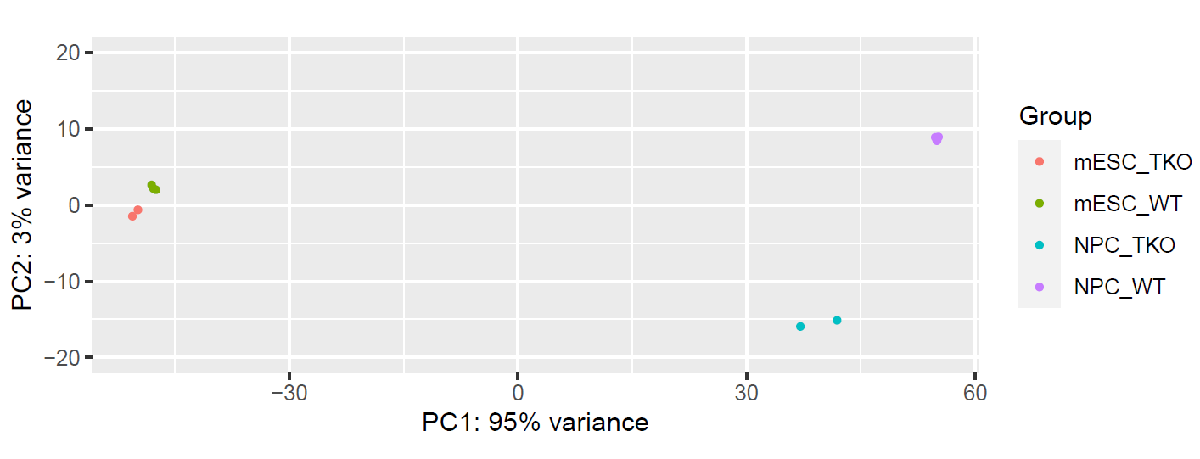
PCA Analysis of Samples
Sample Distance Heatmap Plots

Slide 4
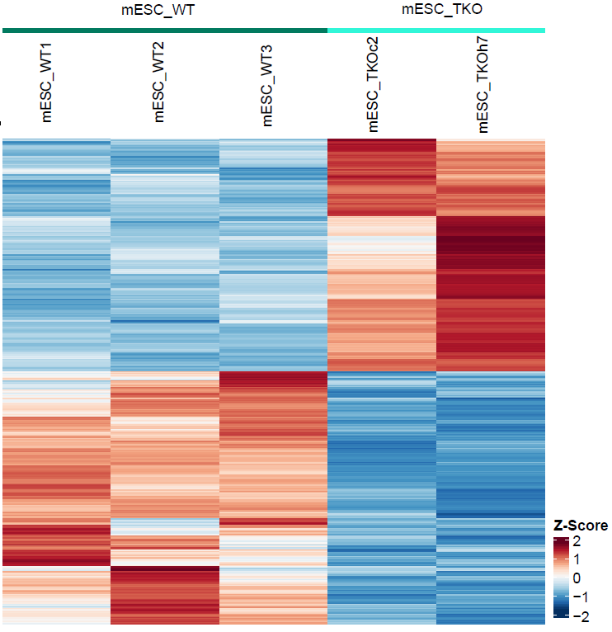

Slide 5
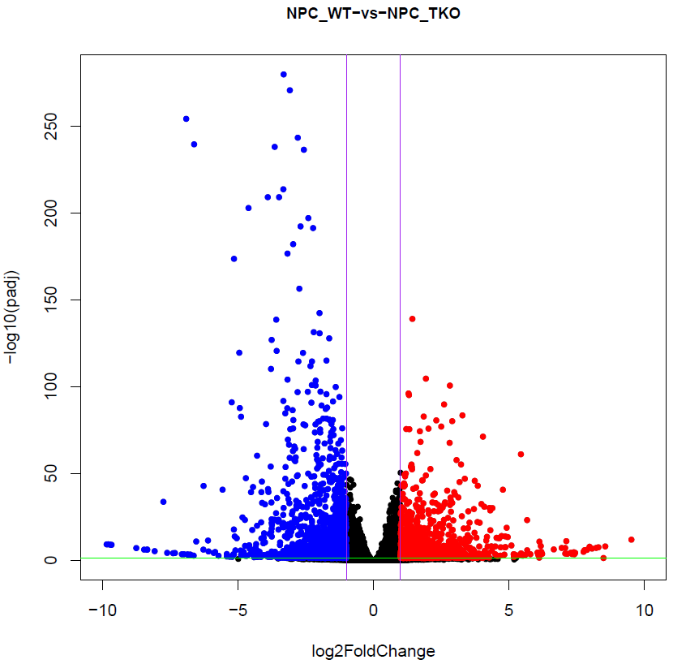
Volcano Plots (FDR<0.05 abs(Log2FC)>1)

Slide 6
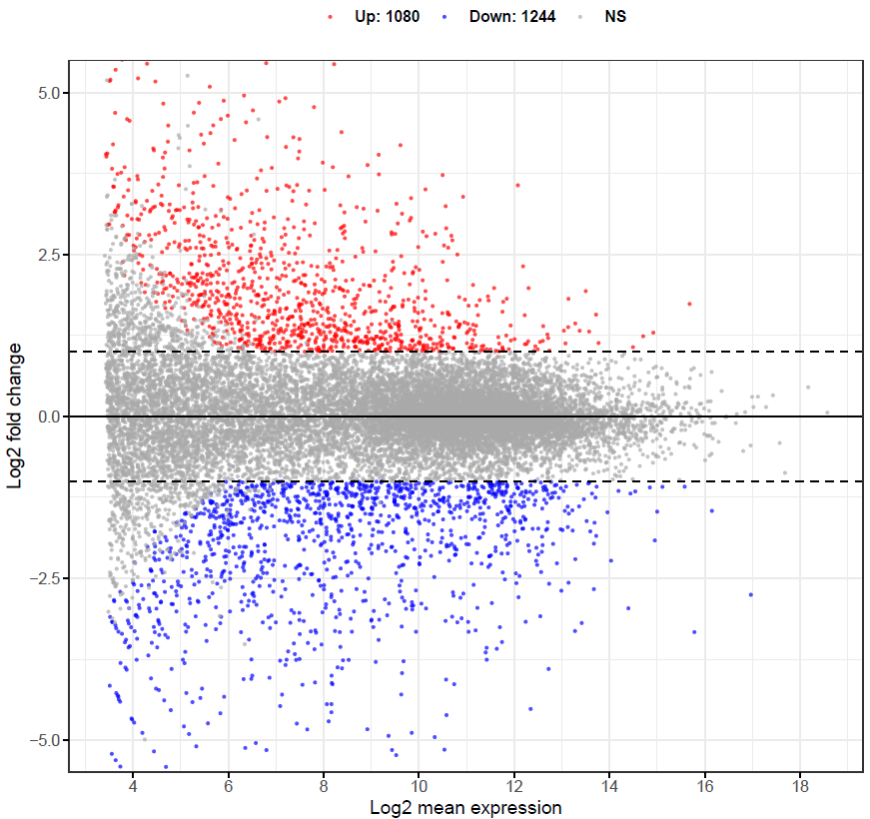
MA Plots (FDR<0.05 abs(Log2FC)>1)

Slide 7
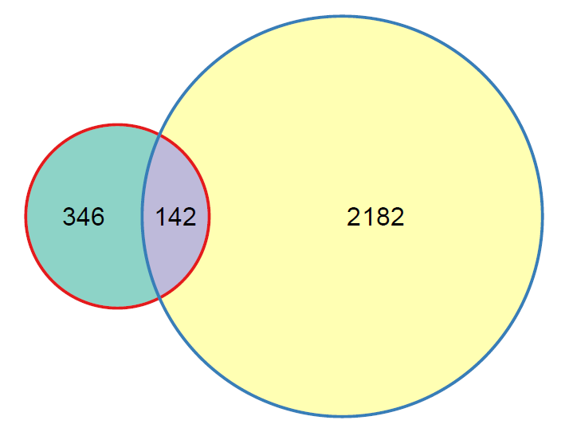
Venn Diagram

Slide 8
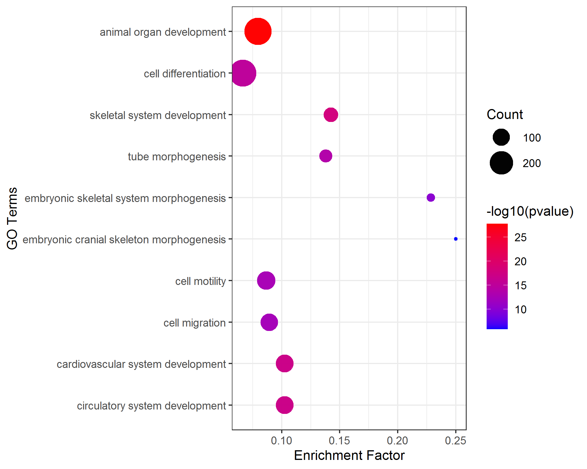
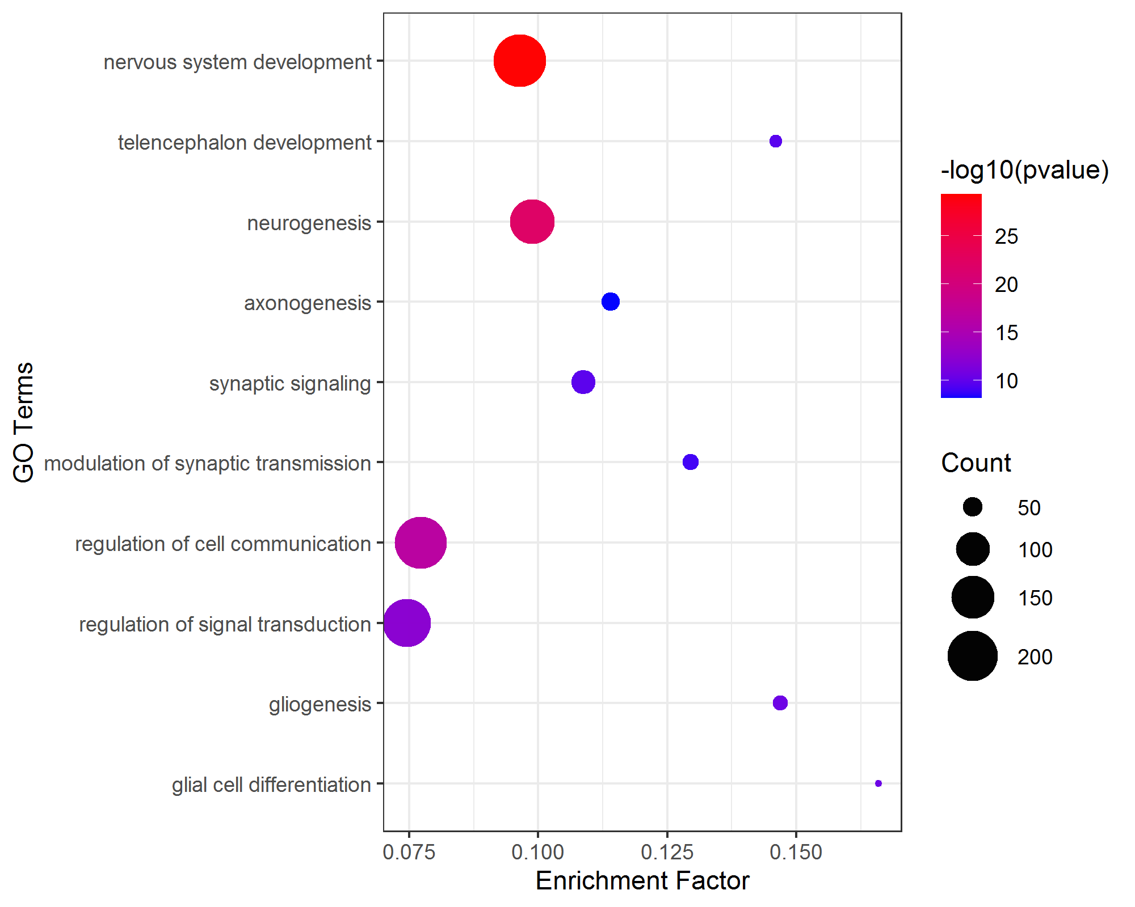
Bubble Plots
Up DEGs
Down DEGs

Slide 9
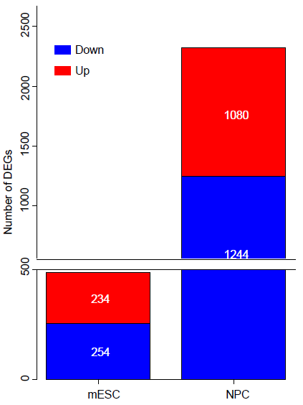
BarPlot

